Slide 1

Energy Market Update
Pilot Power Group, LLC
July 27, 2020

Slide 2
ENERGY OVERVIEW
Required Procurement Products
Settlement Pricing
            Baseload – System Energy
            Renewable Energy
            Resource Adequacy
            Central Procurement Agency
            Impacts of COVID-19
            Timing on Procurement

Slide 3
REQUIRED PROCUREMENT PRODUCTS
Base Load/System Energy – electric power needed to supply the needs of your customers
Block Purchases
Shaped Purchases
Day-Ahead
Real-Time
Resource Adequacy – Incentivize the siting and construction of new resources needed for future grid reliability
Local
System
Flexible

Slide 4
REQUIRED PROCUREMENT PRODUCTS
Portfolio Content Category (PCC)
Renewable Energy PCC1 – minimum 75% of your RPS requirement must come from bundled resources (energy and renewable energy credit)
Renewable Energy PCC2 – 15-25% of your RPS requirement can come from firm and shaped with substitute electricity
Renewable Energy PCC3 – maximum 10% of your RPS requirement can come from unbundled RECs

Slide 5
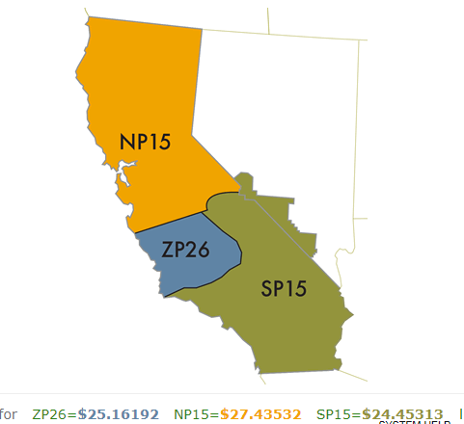
SETTLEMENT PRICING
California is divided into three regions or hubs
Path 15 – is an 84 mile portion of the north-south power transmission corridor
North Path 15 (NP15), South Path 15 (SP15), and Path 26 (ZP26) are all financial hubs for settlement of energy contracts
http://oasis.caiso.com/mrioasis/logon.do

Slide 6
ENERGY PRICES
North Path 15 – Calendar (Cal) averages have dropped comparing 2019 to 2020 forecasts
Forecast Date | Cal21 On- Peak | Cal21 Off-peak | Cal22 On- Peak | Cal22 Off-peak | Cal23 On- Peak | Cal23 Off-peak
7/8/2019 | $42.04 | $35.35 | $43.18 | $36.76 | $44.00 | $37.63
7/8/2020 | $38.72 | $32.13 | $36.82 | $31.72 | $35.47 | $31.66
Delta | -3.32 | -3.22 | -6.36 | -5.04 | -8.53 | -5.97

Slide 7
ENERGY PRICES

Slide 8
ENERGY PRICES

Slide 9
RENEWABLE ENERGY
PCC1 – Procurement of Energy and REC delivered to California balancing authority (CBA) without substitution electricity
PCC2 – Procurement of Energy that cannot be delivered to a CBA without substituting electricity from another source
PCC3 – Unbundled renewable energy credits, no electricity component
*Based on average contracted prices

Slide 10
RESOURCE ADEQUACY
LOCAL – Procurement from ‘local’ resources where supply is needed due to insufficient transmission to serve the entire load
FLEXIBLE – Procurement from ‘flexible’ resources that can ramp up or down on short notice to meet variations in load
SYSTEM – Procurement from ‘system’ resources ensures that those resources will be available to serve CAISO demand when needed.
*Based on average contracted prices

Slide 11
CENTRAL PROCUREMENT ENTITY (CPE)
The IOUs would purchase the entire amount of required local resource adequacy for 2023 on behalf of all load serving entities (LSEs)
Departure from current framework for ensuring local reliability
Limits the CCA’s control on cost of goods sold
Shift in the local resource adequacy market, moving from a market with many buyers, to one dominated by the PG&E and SCE.
CPE is allowed to procure any associated system and flexible RA capacity with mandatory allocation of these rights to LSEs without time to position their own portfolios.
Possible discouragement for investment in ‘behind the meter’ resource options

Slide 12
IMPACTS OF COVID-19
California ISO has curtailed renewable energy at record levels, as solar power increasingly outpaces electricity demand
California ISO has seen load reductions from 5 to 8 percent on weekdays, and from 1 to 4 percent on weekends
Shifts in demand from commercial, restaurant and retail hubs to residential consumption
COVID-19 is not solely responsible for renewable curtailment, as curtailment has been rising every year, due to the growth in solar power
COVID-19 has impacted the renewable industry in California, with an estimated 35,687 jobs lost (June 2020) and 373.01 MWdc solar deployment loss (2nd Qtr.)
Procurement for energy, renewables and other related products is challenging due to credit

Slide 13
TIMING OF PROCUREMENT – RESOURCE ADEQUACY
  Year Ahead must be procured by October to meet the RA filing date
  Local - 100% (Year 1 and 2), Local 50% (Year 3)
  System - 90% (May - September)
  Flexible - 90% (each month of the coming compliance year)
  Month Ahead – 100% must be procured 45 days prior to compliance month

Slide 14
Questions
Contract: Denis Vermette
Pilot Power Group, LLC
dvermette@pilotpowergroup.com

